Slide 1


Prof. Roseanna Hopper
ALY 6015​ Final Project
Portuguese Bank Marketing Data Set
By
Sunil Raj THOTA
Nalini MACHARLA

Slide 2







Introduction
Portuguese Bank’s
Direct Marketing Campaigns
Data Preprocessing
Data Exploration
Data Modelling
UCI Machine Learning Repository
Open-source
Data Analysis
Prediction
Decision-making

Slide 3
Business Problem
Actions to take for Revenue Decline?
Predict if the client will subscribe (yes/no) a term deposit (variable y)?
Identify existing Clients?
Which Feature Selection Technique should be used for our data?

Slide 4
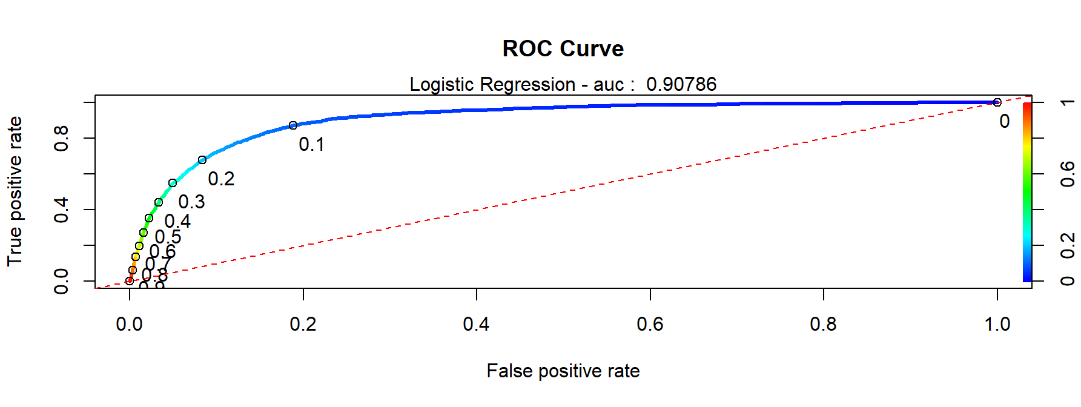
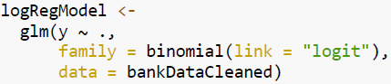
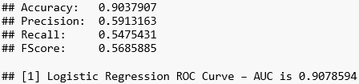
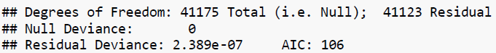
Logistic Regression
Logistic is an appropriate regression analysis to perform when the dependent variable is dichotomous or binary
It predicts the probability of occurrence of an incident by fitting data to a logit function
So, We chose logistic regression model to discover the Client subscription with accuracy of 90.38%

Slide 5

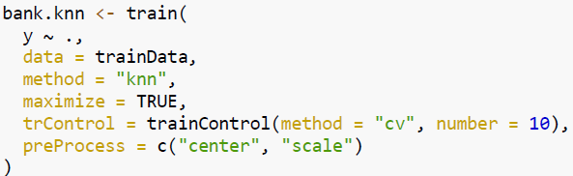
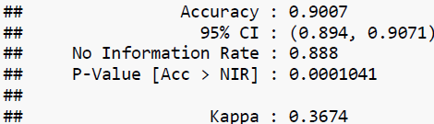
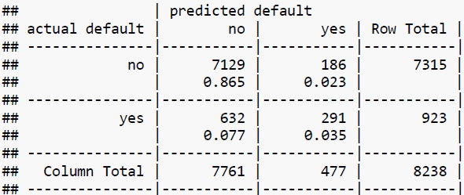
k-Nearest Neighbors
The low bias/ high variance classifiers considered is k-Nearest Neighbors, it is a supervised learning algo
We train it under supervision using the labelled data which is already available to us
Another parameter was preProcess, where the data was centred and scaled
KNN method for the 80/20 test/training split’s accuracy is 90.07%

Slide 6
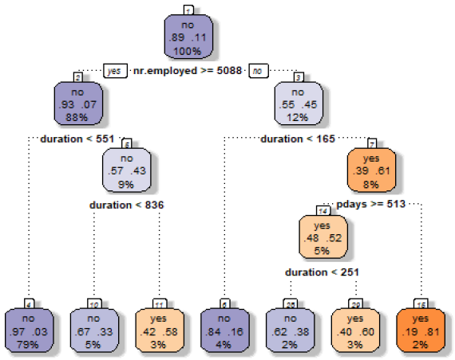
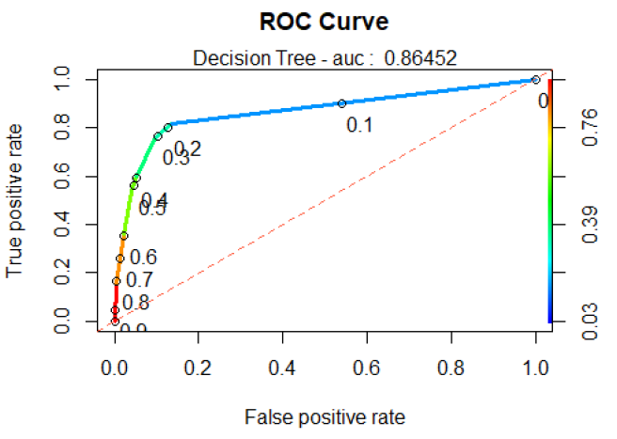
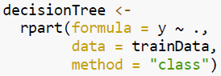
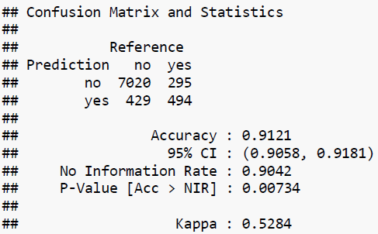
Decision Tree
It is one of the very simplest and useful ML algorithms and used to predict a class of the given data
The results show that the model are fitted to evaluate train data considering that errors is so low 8.1%
Decision Tree seems to be a better classifier with the accuracy achieved with this model is about 91.21%

Slide 7
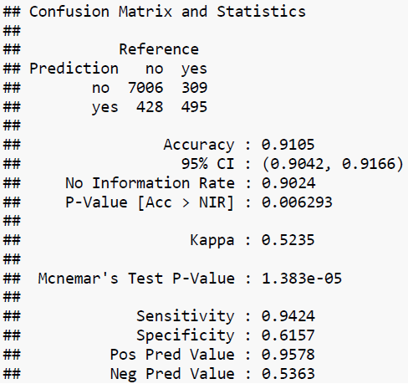
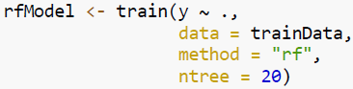
Random Forest
The random forest then combines the output of individual decision trees to get the ultimate output
This process of mixing the output of multiple individual models is called as Ensemble Learning
After rigorous training and testing with 20 dimensions, we obtained an accuracy of 91.05%

Slide 8
Conclusion
MODEL | ACCURACY (%) | RANK
Logistic Regression | 90.38 | 3
k-Nearest Neighbors | 90.07 | 4
Decision Trees | 91.21 | 1
Random Forests | 91.05 | 2
The Decision Tree Model produces the most accurate predictions of client will subscribe (yes/no) a term deposit information
The accuracy of the predictions are verified with a Probability Value of 0.00734 and a 95% confidence interval of 0.9058 to 0.9181
For better understanding we can go further by building XG Boost, Ada Boost, GBM, Light GBM, and Neural Network Models and figure out the best accurate predictor and use it in the Bank’s Marketing Campaign

